Slide 1
BMW GLOBAL SALES & MARKET TRENDS
“The Drive That Never Stops”
Presented by ,
Mrs. Sivadurga K
Group 11.

Slide 2
Over all analysis
2008-2010 financial crisis
Growing interest in electric vehicles (EVs)
Classics series: 3 series and 5 series
Launch of i3 and i8

Slide 3
key insights
Income generation high end model: 7 series
Seasonal pattern : Peaking in September and dropping in December
Customer preferences: Manual cars and the color Red
Yearly sales trends
Yearly drops: 2018–2020 and 2023 Drop
Major growth periods: 2019, 2021,2022, and 2024

Slide 4
Income generation high end model: 7 series

Slide 5
Seasonal pattern : Peaking in September and dropping in December

Slide 6
Customer preferences: Manual cars and the color Red

Slide 7
Yearly drops: 2018–2020 and 2023 Drop
Major growth periods: 2019, 2021,2022, and 2024

Slide 8
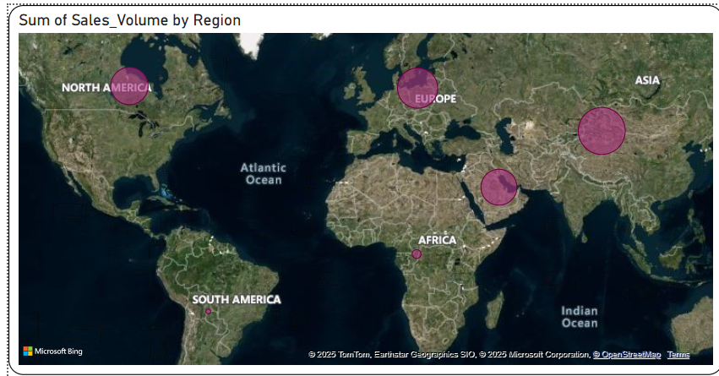
Sales by region

Slide 9
BMW's Roadblocks
Steep fall in 2018 - 2020 and 2023
China lockdowns (early 2022)
13.4% drop in global deliveries for the first six months of 2022
Breaking system issues (2023)
Supplier part shortages in earlier years (2017),

Slide 10
Steps BMW could have been taken to overcome the challenges
Our team analysed the data and suggested some the preventive measures. Here they are
Stop relying on one source
Diversifying suppliers
Adapting to market challenges
Product flexibility
Technological advancements

Slide 11
RE-rise of BMW
Every trend, every model, and every market shift told a story of a company that refused to slow down.
However, the launch of the i3 and i8 manifest the beginning of BMW's electric vision.
The growth in Asia showed how the brand adapted to new markets.
And the steady sales in Europe proved that innovation never meant leaving tradition behind.
And that’s the story I want to share with you today, how BMW turned challenge into opportunity, and how their journey during those years shaped the brand we know today.”
Thank you for the dedication and time given to me.

